Slide 1
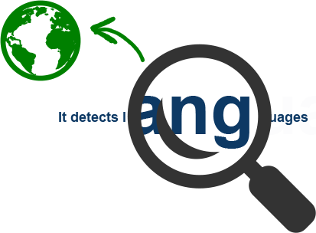

Language Detector & Translator
Saloni Sharma
1st Year (2nd Semester)
M.Tech (Statistical Computing in Data Science)

Slide 2
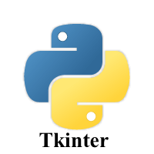

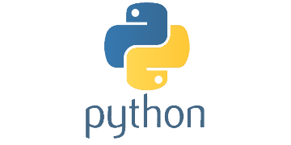
Project Prerequisites
Basic Knowledge of Python
For making GUI
based interface
Google Translate API

Slide 3
Libraries & Modules
Libraries | Use
Tkinter | GUI library for Python
googletrans | Used to translate text
iso639 | Contain more than 500 languages
langdetect | For Language detection
Modules | Use
ttk | Give access to TK widget
Translator | Used to do Translation
LANGUAGES | List of all supported languages in the Python dictionary
languages | Used for converting language code to its name(iso-639)
DetectorFactory | Enforce consistent results, if ambiguity found

Slide 4
Use case diagram
Load the Application
Type sentence in any Language to Detect (Detection)
User
Choose the target language to translate (Translation)
Check the
output box
(Translated Result)

Slide 5
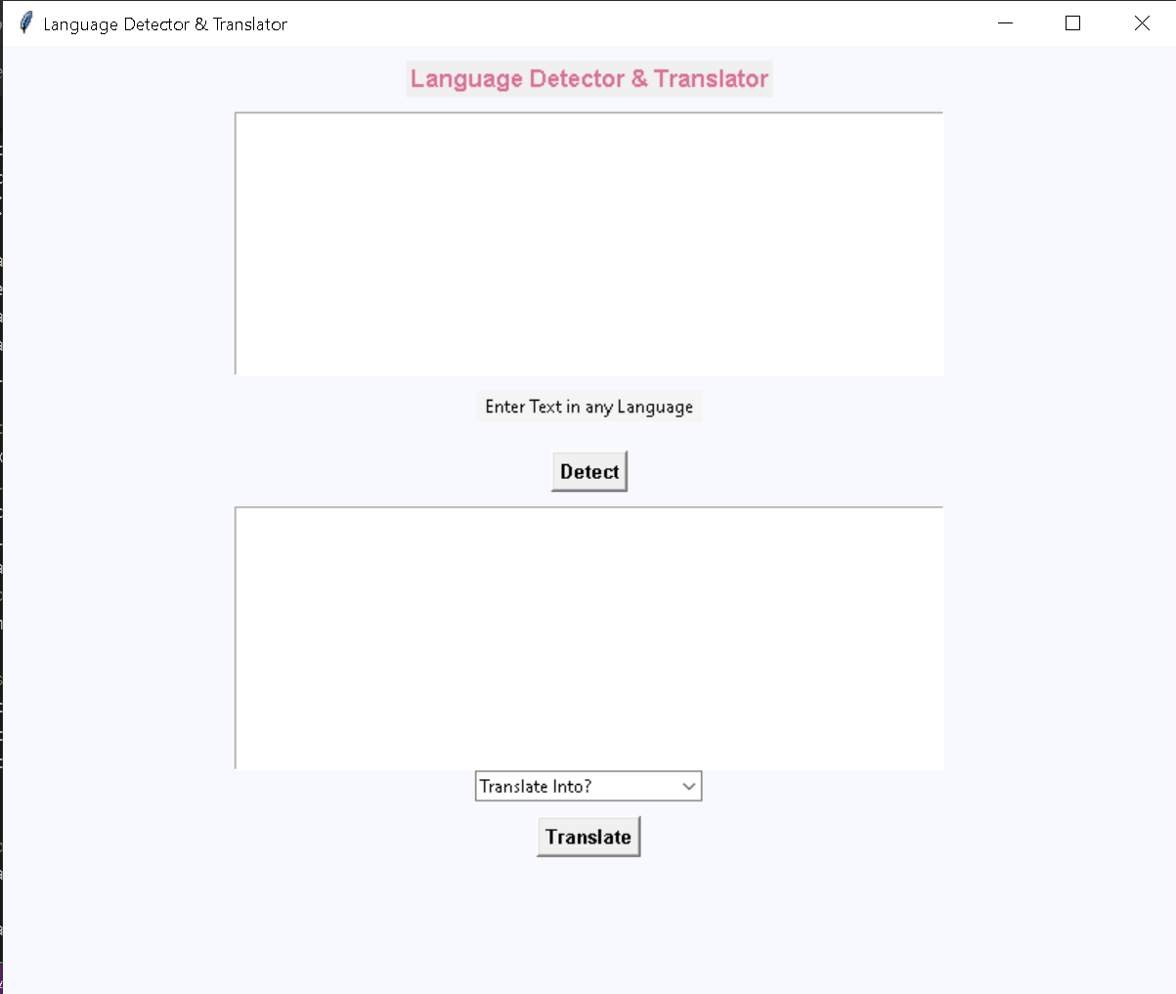
Project
Type any sentence in any language
Press “Detect” button

Slide 6
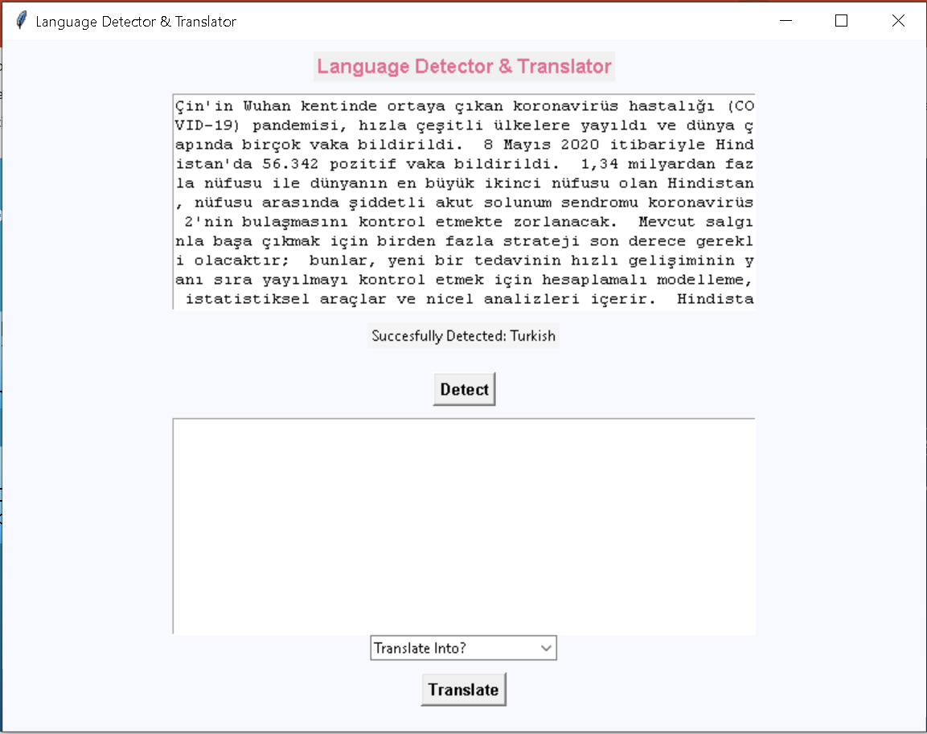
Project
Detected Language

Slide 7
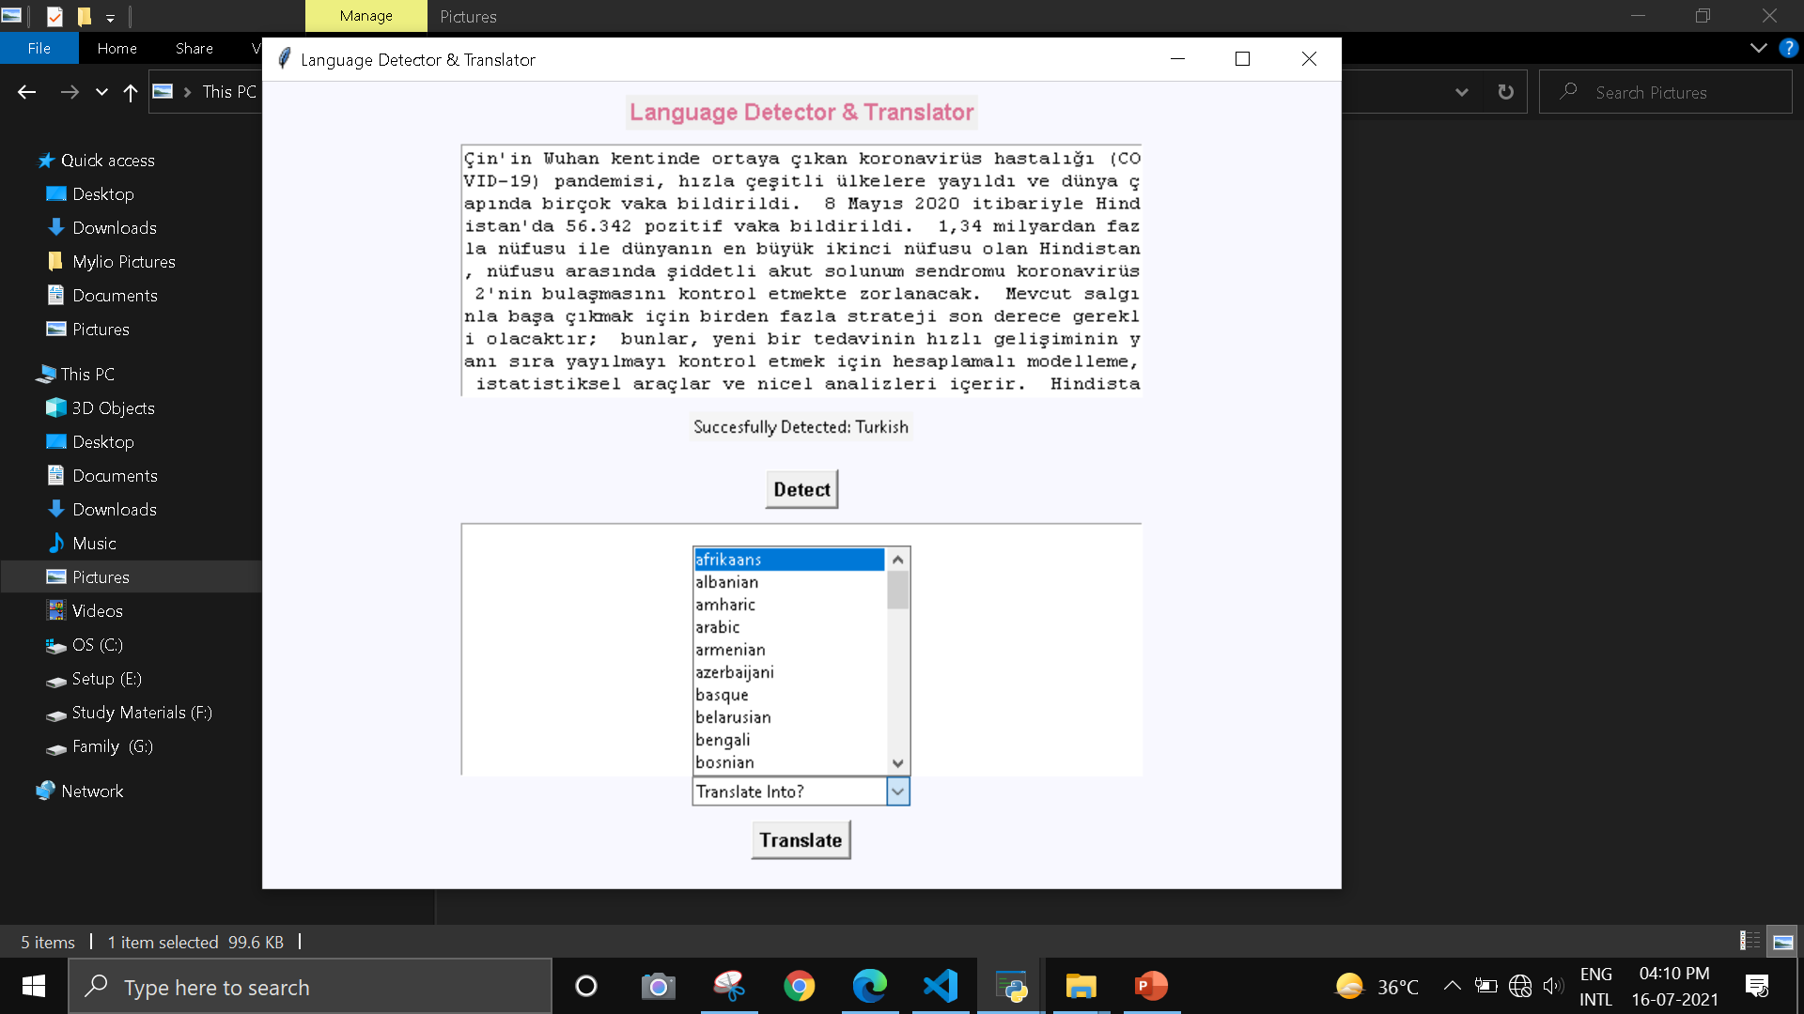
Project
Choose the Language in which you want to Translate
Press “Translate” button

Slide 8
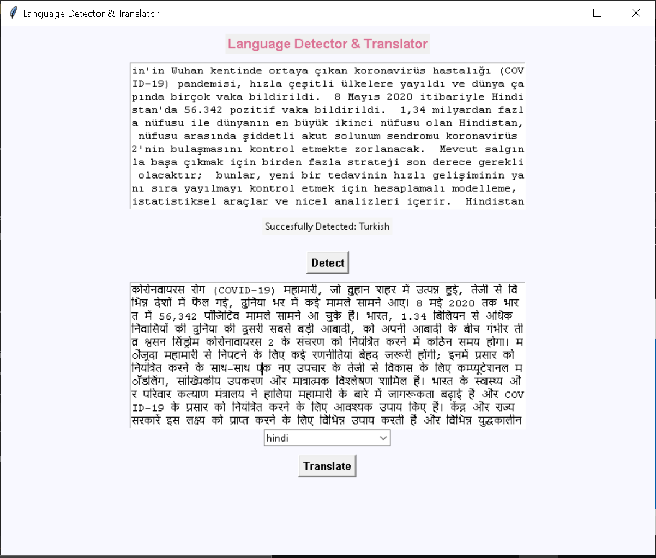
Project
Translated Language

Slide 9
Advantage
It support 55 languages for detection.
It can translate detected language into any of 107 languages provided.
For Language detection, no need of internet connectivity.
Fast and reliable.
disadvantage
For translation you must have Internet connectivity.
For running this project Python should be installed in your system
Maximum character limit on a single text is 15k

